Slide 1
QLSTMs for audio denoising
Filippo Villani 1706489

Slide 2
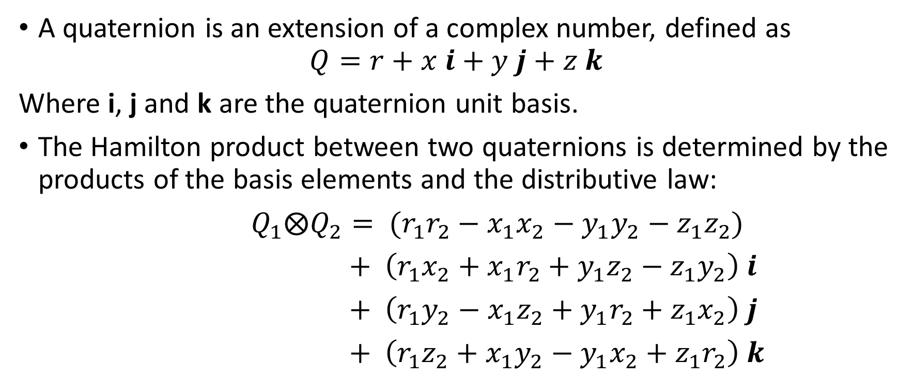
Quaternion Algebra
A quaternion is an extension of a complex number, defined as
$$Q=r+x i+y j+z k$$
Where i, j and k are the quaternion unit basis.
The Hamilton product between two quaternions is determined by the products of the basis elements and the distributive law:
$Q_{1}⨂Q_{2}= {(r}_{1}r_{2}−x_{1}x_{2}−y_{1}y_{2}−z_{1}z_{2})$
$+ \left(r_{1}x_{2}+x_{1}r_{2}+y_{1}z_{2}−z_{1}y_{2}\right) i$
$+$ $\left(r_{1}y_{2}−x_{1}z_{2}+y_{1}r_{2}+z_{1}x_{2}\right) j$
$+$ $\left(r_{1}z_{2}+x_{1}y_{2}−y_{1}x_{2}+z_{1}r_{2}\right) k$
(1)
(2)

Slide 3
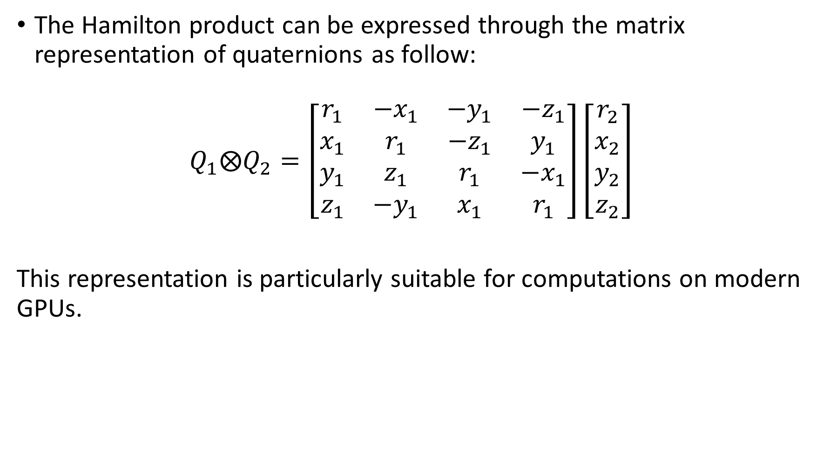
The Hamilton product can be expressed through the matrix representation of quaternions as follow:
$$Q_{1}⨂Q_{2}=\left[\begin{matrix}r_{1} & −x_{1} & −y_{1} & −z_{1} \\ x_{1} & r_{1} & −z_{1} & y_{1} \\ y_{1} & z_{1} & r_{1} & −x_{1} \\ z_{1} & −y_{1} & x_{1} & r_{1}\end{matrix}\right]\left[\begin{matrix}r_{2} \\ x_{2} \\ y_{2} \\ z_{2}\end{matrix}\right]$$
This representation is particularly suitable for computations on modern GPUs.
(3)

Slide 4
QNNs pros and cons
QRNNs can learn both intra-sequence dependencies, just like a regular RNN, and inter-sequence dependencies.
We can exploit this property by feeding the network a multi-microphone speech processing scenario and assigning each microphone to a different quaternion unit basis. In this way, the network can learn the dependencies between the microphones.
QRNNs reduce by a maximum factor of 3.8 the number of free parameters needed compared to RNNs, thus leading to a more compact representation of the relevant information.
QNNs are computationally more expensive than real-valued NNs because the Hamilton product involves 28 basic operations compared to 1 for a standard product.

Slide 5
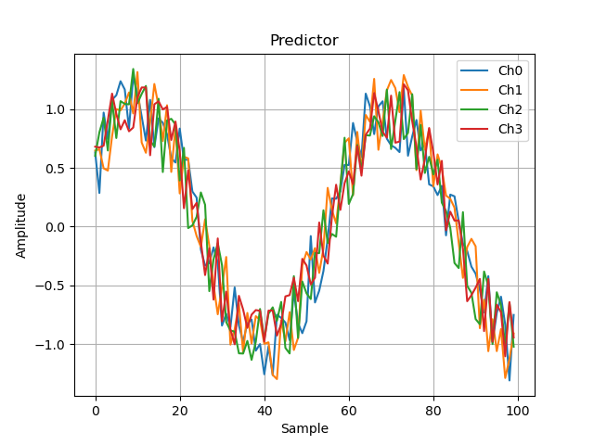
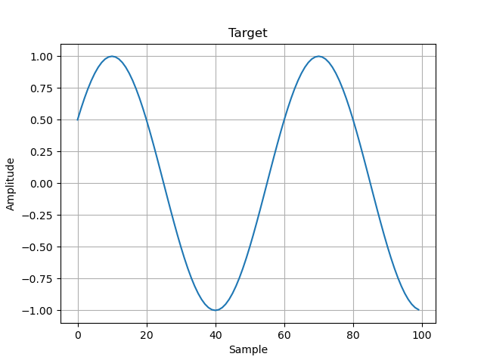
Dataset
I tried to use the L3DAS21 task 1 dataset which consists of a corpus of audio signals recorded with two ambisonic microphones that output 4 channels each.
Unfortunately, my hardware wasn’t able to complete the training in a feasible time (10 epochs were going to last about 600 hours), so I decided to train the networks on a dataset of noisy sinusoids over 4 channels.

Slide 6
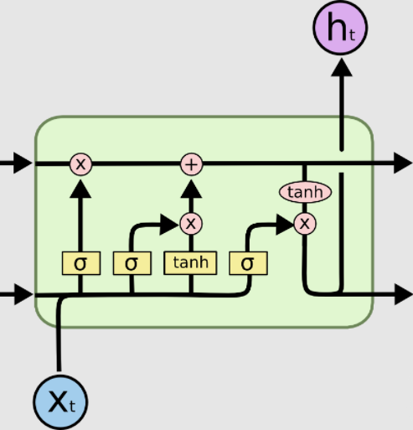


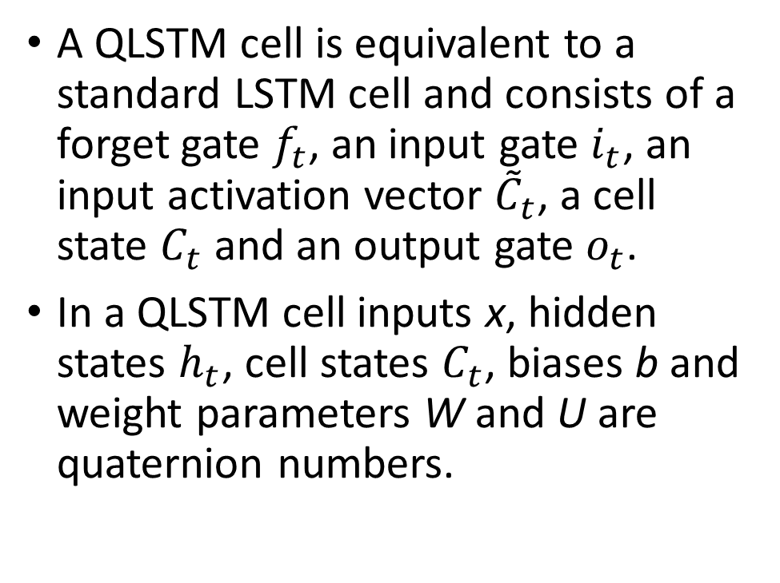





Quaternion Long-Short Term Memory Cell
A QLSTM cell is equivalent to a standard LSTM cell and consists of a forget gate $f_{t}$, an input gate $i_{t}$, an input activation vector ${\tilde{C}}_{t}$, a cell state $C_{t}$ and an output gate $o_{t}$.
In a QLSTM cell inputs x, hidden states $h_{t}$, cell states $C_{t}$, biases b and weight parameters W and U are quaternion numbers.
$$C_{t−1}$$
$$C_{t}$$
$$i_{t}$$
$$o_{t}$$
$$f_{t}$$
$${\tilde{C}}_{t}$$
$$h_{t−1}$$

Slide 7
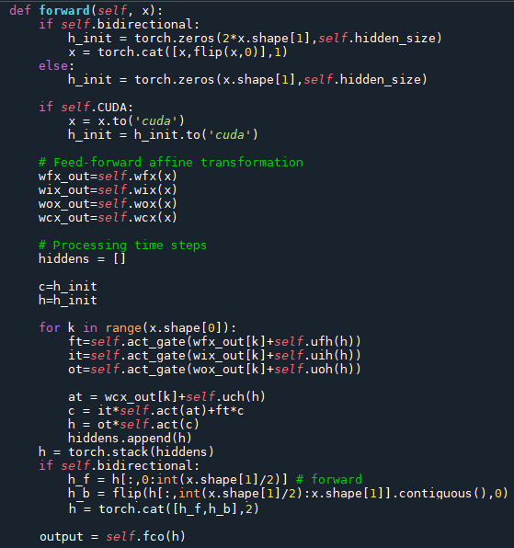

Forward Phase
A QLSTM layer can be summarized by the following equations that, except for the Hamilton product, are equivalent to standard LSTM equations:
(4a)
$f_{t}= σ\left(U_{fh}⊗h_{t−1}+W_{fx}⨂x_{t}+b_{f}\right)$,
$i_{t}= σ\left(U_{ih}⊗h_{t−1}+W_{ix}⨂x_{t}+b_{i}\right)$,
${\tilde{C}}_{t}=U_{Ch}⨂h_{t−1}+W_{Cx}⨂x_{t}+b_{C}$,
$C_{t}=f_{t}⨂C_{t−1}+i_{t}⨂tanh⁡({\tilde{C}}_{t})$,
$o_{t}=σ(U_{oh}⨂h_{t−1}+W_{ox}⨂x_{t}+b_{o})$,
$h_{t}=o_{t}⊗tanh⁡(C_{t})$.
(4b)
(4c)
(4a)
(4d)
(4b)
(4e)
(4e)
(4c)
(4d)
(4f)
(4f)

Slide 8
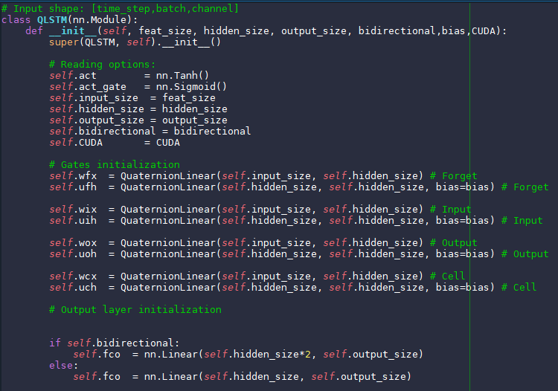
QLSTM initialization
This network consists of a QLSTM layer and a fully connected layer which performs the regression operation.
The fully connected layer hasn’t got an activation function because we don’t want to bound the network’s output.

Slide 9
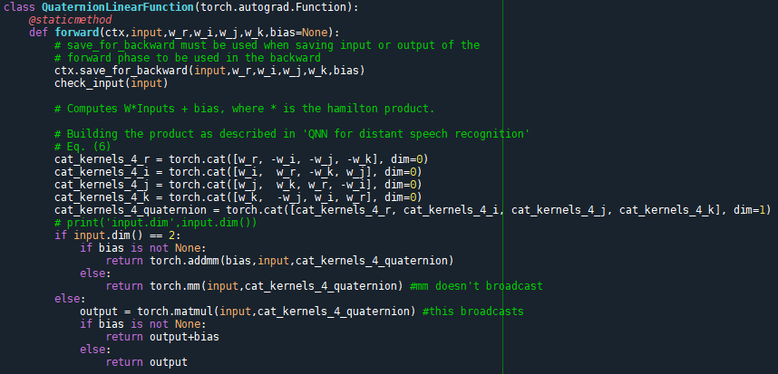
QuaternionLinearFunction is called by QuaternionLinear and performs the Hamilton product between the weights and the input data during the forward phase.
Hamilton product is performed as described in Equation (3).

Slide 10
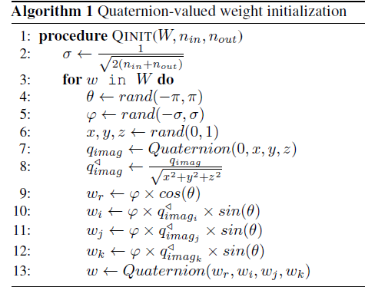
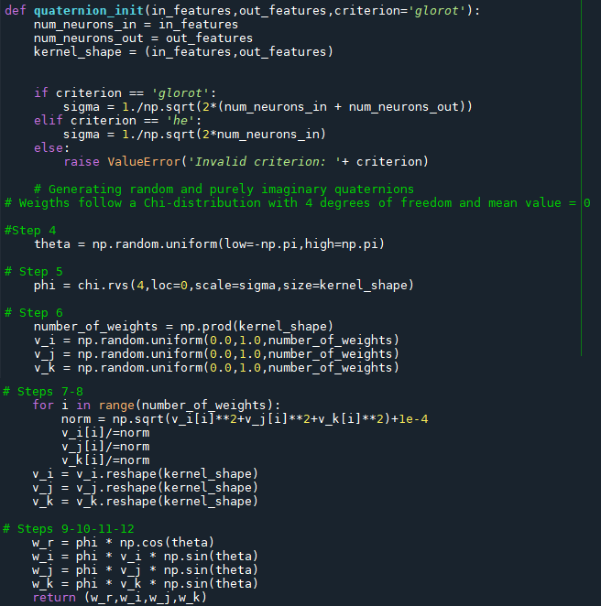
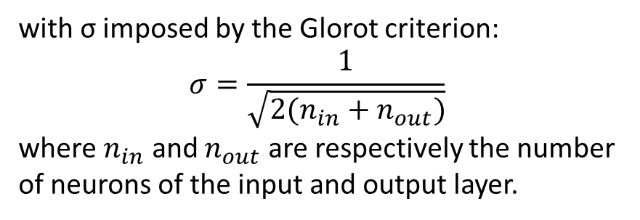
QuaternionLinear is also responsible to initialize the weights as described by Parcollet T. in ‘Quaternion Recurrent Neural Networks’:
with σ imposed by the Glorot criterion:
$$σ=\frac{1}{\sqrt{2(n_{in}+n_{out})}}$$
where $n_{in}$ and $n_{out}$ are respectively the number of neurons of the input and output layer.
(5)

Slide 11
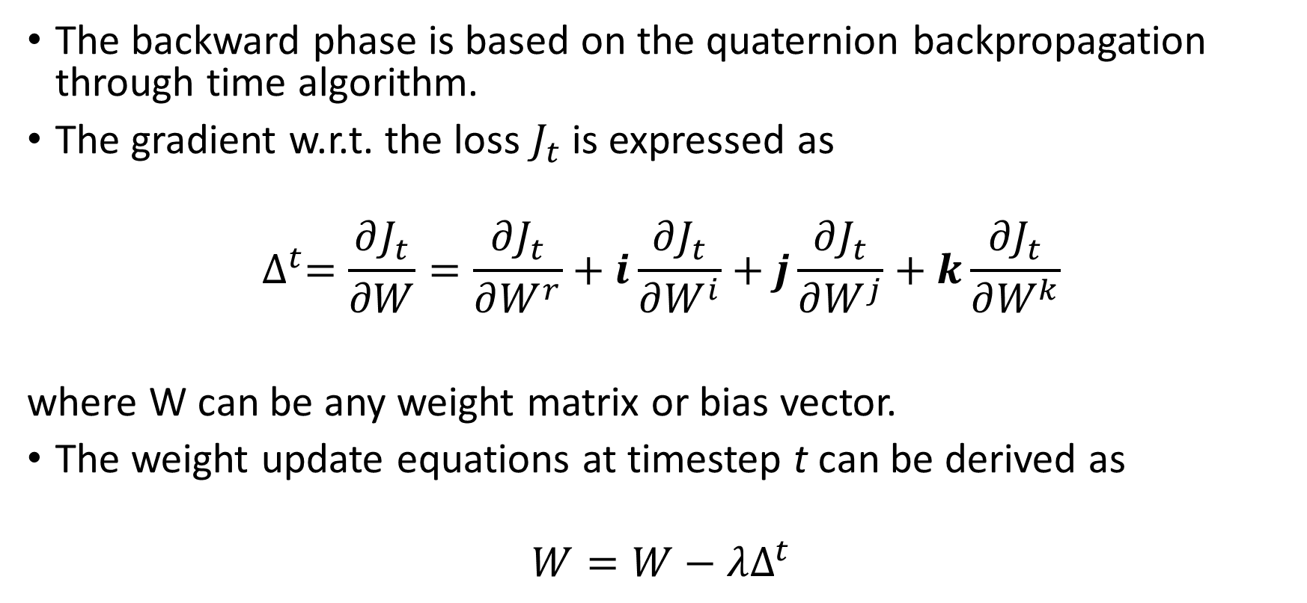
Backward Phase
The backward phase is based on the quaternion backpropagation through time algorithm.
The gradient w.r.t. the loss $J_{t}$ is expressed as
$$∆^{t}=\frac{∂J_{t}}{∂W}=\frac{∂J_{t}}{∂W^{r}}+i\frac{∂J_{t}}{∂W^{i}}+j\frac{∂J_{t}}{∂W^{j}}+k\frac{∂J_{t}}{∂W^{k}}$$
where W can be any weight matrix or bias vector.
The weight update equations at timestep t can be derived as
$$W=W−λΔ^{t}$$
(6)
(7)

Slide 12
Training
I trained two real-valued models (LSTM and Bi-LSTM) and two quaternion models (QLSTM and Bi-QLSTM) over 150 epochs, using a patience of 20 epochs.
I used MSE as loss function and Adam as optimizer.
I halved the learning rate every time the validation loss didn’t increase for three times in a row, ensuring an optimal convergence.
I tried to train multilayer versions of these networks but they overfit because the input data are too simple. Multilayer versions may be more suitable for more complex data, such as L3DAS21 dataset.

Slide 13
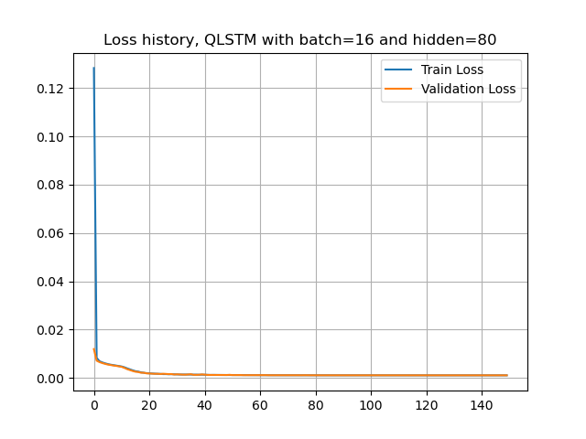


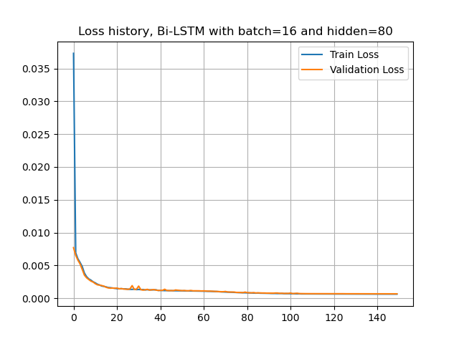
Loss History

Slide 14
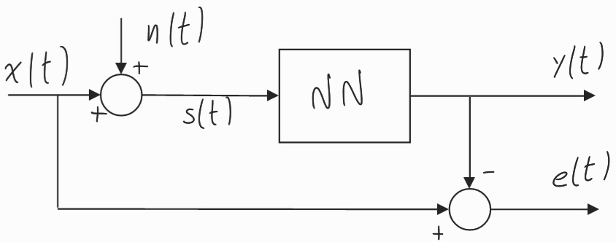
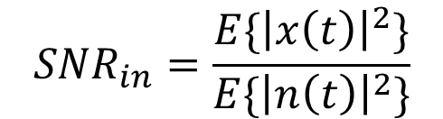

Evaluation
I measured the SNR improvement after the NNs and used it as a metric for the denoising task.
x(t) is the target,
n(t) is additive noise,
s(t) is the predictor,
y(t) is the predicted tensor,
e(t) is the prediction error.
$${SNR}_{in}=\frac{E\{{\left|x\left(t\right)\right|}^{2}\}}{E\{{\left|n\left(t\right)\right|}^{2}\}}$$
$${SNR}_{out}=\frac{E\{{\left|x\left(t\right)\right|}^{2}\}}{E\{{\left|e\left(t\right)\right|}^{2}\}}$$

Slide 15
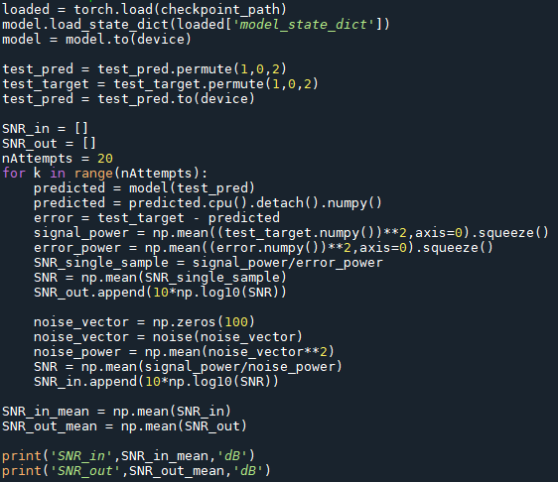

I computed the SNR for every sample in the test set and then I took the mean value of these SNR values.
To hold in consideration the variability of the function noise I repeated this evaluation nAttempts times.

Slide 16
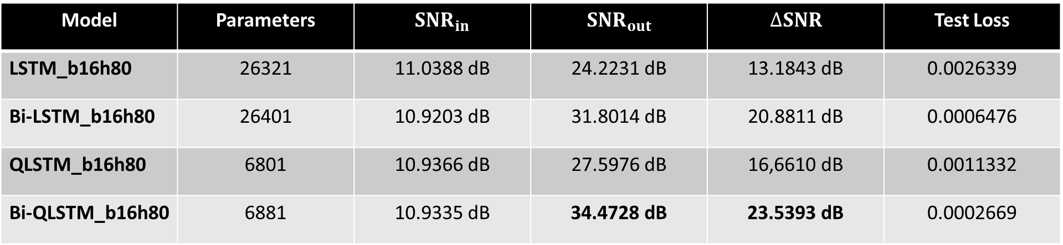
Results
Model | Parameters | $${SNR}_{in}$$ | $${SNR}_{out}$$ | $$∆SNR$$ | Test Loss
LSTM_b16h80 | 26321 | 11.0388 dB | 24.2231 dB | 13.1843 dB | 0.0026339
Bi-LSTM_b16h80 | 26401 | 10.9203 dB | 31.8014 dB | 20.8811 dB | 0.0006476
QLSTM_b16h80 | 6801 | 10.9366 dB | 27.5976 dB | 16,6610 dB | 0.0011332
Bi-QLSTM_b16h80 | 6881 | 10.9335 dB | 34.4728 dB | 23.5393 dB | 0.0002669
In model’s column, b stands for batch size and h for hidden size.
These are the best hyperparameters I found for QLSTMs after some fine-tuning.

Slide 17
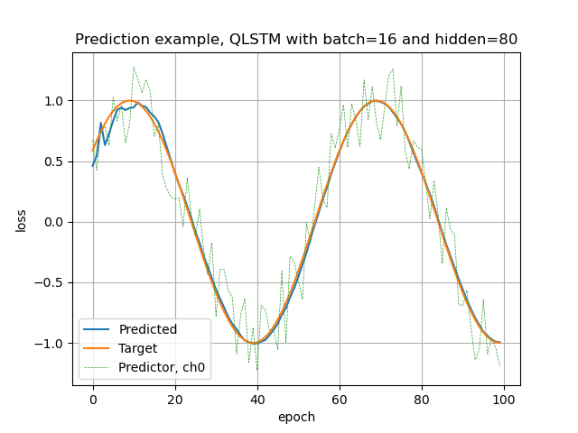
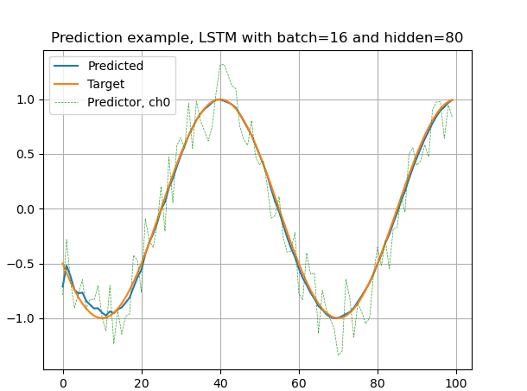
(Q)LSTM predictions

Slide 18
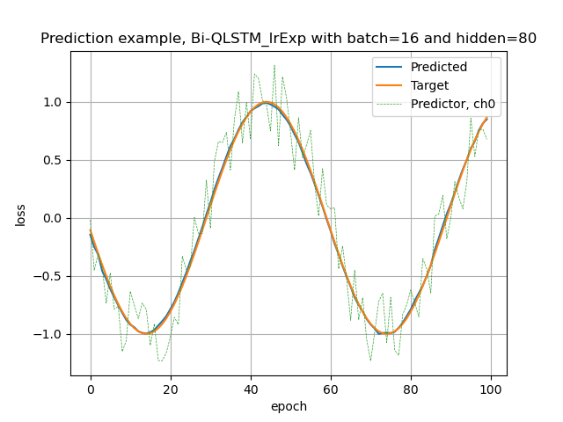
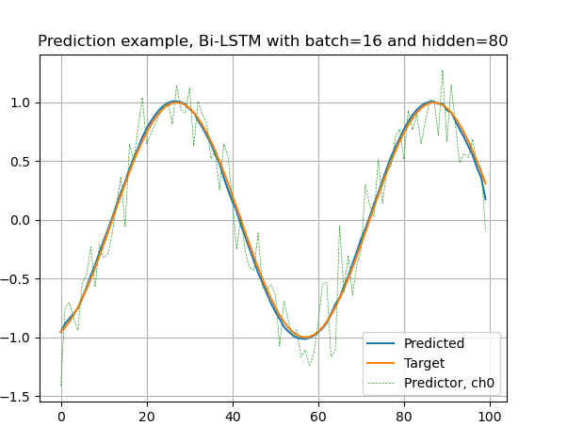
Bi-(Q)LSTM predictions

Slide 19
Unidirectional networks led to an initial transient where the predictions had a higher error power than next samples.
This error can be attenuated by bidirectional (Q)LSTMs.
Bi-QLSTM first samples
QLSTM first samples

Slide 20
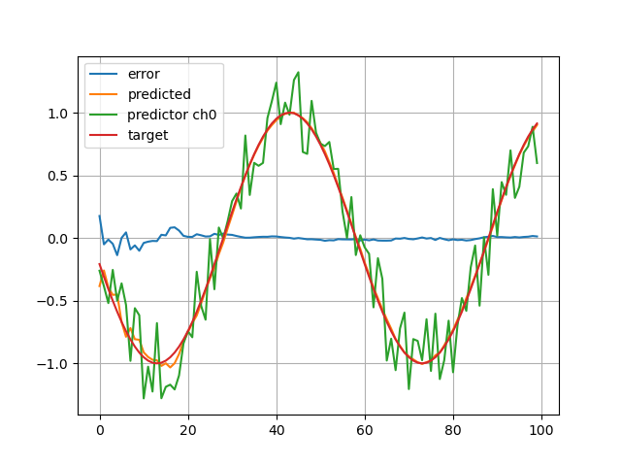
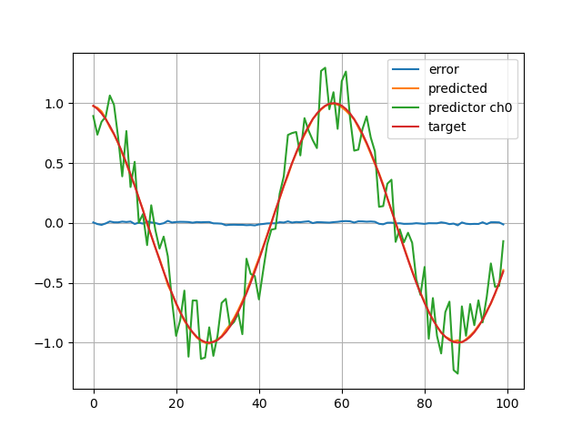
In these plots we can see how the error on the first samples of the predictions is reduced by the Bidirectional QLSTM.
QLSTM
Bi-QLSTM

Slide 21
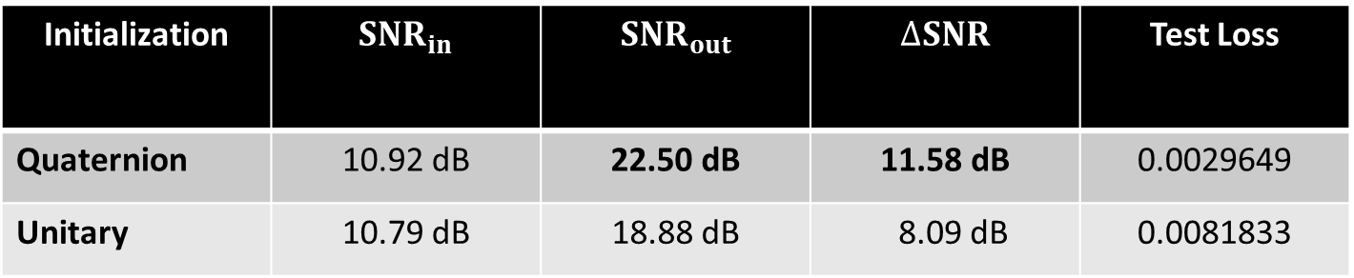
The importance of initialization
I trained the same QLSTM model (batch size = 32, hidden size = 80) over 30 epochs using the quaternion weight initialization described earlier and a unitary weight initialization, i.e. with weights drawn out of a uniform distribution between -1 and 1.
The model initialized in the former way outperformed the latter, as shown below
Initialization | $${SNR}_{in}$$ | $${SNR}_{out}$$ | $$∆SNR$$ | Test Loss
Quaternion | 10.92 dB | 22.50 dB | 11.58 dB | 0.0029649
Unitary | 10.79 dB | 18.88 dB | 8.09 dB | 0.0081833

Slide 22
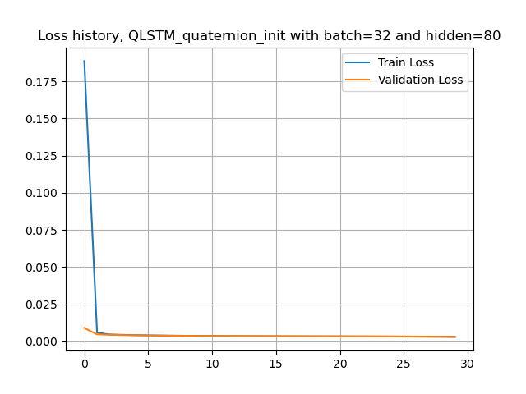
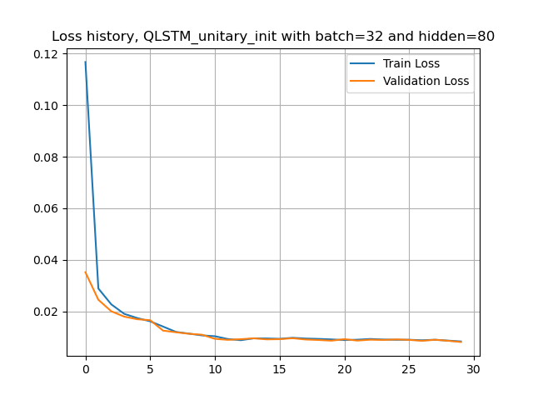
These plots show how the model with the unitary initialization converges slower than the one initialized as described by Parcollet.

Slide 23
References
Parcollet T., Ravanelli M. , Morchid M. , Linarès G., Trabelsi C., De Mori R., and Bengio Y., “Quaternion recurrent neural networks,”arXiv preprint arXiv:1806.04418, 2018.
Qiu X., Parcollet T., Ravanelli M., Lane N., Morchid M., “Quaternion Neural Networks for Multi-channel Distant Speech Recognition”, arXiv:2005.08566, 2020.
Danilo Comminiello, & Eric Guizzo. (2021). L3DAS21 Challenge (Version V1) [Data set]. IEEE Workshop on Machine Learning for Signal Processing 2021 (MLSP 2021), Gold Coast, Queensland, Australia. Zenodo.

